Slide 1


Enabling Success Through Better
Supply Chain Design

Slide 2
Agenda
“What-If?” Questions - System Design
Supply Chain Modeling - LLamasoft Overview
Supply Chain Guru

Slide 3
“What If?”
We reduced a layer in our EPI supply chain?
We moved from point-to-point pick-up/delivery to multi-stop routes?
We changed our delivery frequency?
We changed the location of our cold stores?
We considered integrating with other vertical programs or Essential Medicines?
We considered changing our buffer stock policies?
We were planning a new vaccine introduction and were worried about our cold chain capacity?
We considered really any change to our supply chain with the goals of increasing Availability, Efficiency, Potency, Equity and reducing Risk

Slide 4
Agenda
“What-If?” Questions - System Design
Supply Chain Modeling - LLamasoft Overview
Supply Chain Guru

Slide 5












The Supply Chain Challenge
Volatility and Change is the New Normal
EXTERNAL FACTORS
INTERNAL FACTORS

Slide 6

With Volatility and Change Come More Questions To Answer
Demand Classification & Segmentation
Risk & Resiliency Strategy
Cost to Serve
Fleet Sizing & Mode Selection
Infrastructure Strategy & Capacity Planning
Transportation Strategy & Policies
Inventory Strategy & Policy Development
Notes:
Demand
How can I better understand the volatility and intermittency of my customers buying behavior and therefore make smarter segmentation decisions? Many tools fail to offer this important consideration, which should be an input to inventory and service strategy
Sourcing & Service
How should products flow? Which customers should get served from where? Who should produce? Who should I buy from? I might get a cheaper price from a supplier further from my plant but is the trade-off in freight worth it? How far are my customers from my service locations?
C2S, TnD
Which customers are profitable and which are not? Can we prune the product portfolio or even some customers without impairing capacity utilization and thereby improve margins? Should we be leveraging bonded warehouses and free trade zones?
Infrastructure Strategy
If we were erase the map and design a supply chain from scratch, what would it look like? Can we compare that to have we have now? Or can we overlay our supply chain with a business we are considering acquiring and figure out the synergies and opportunities to consolidate and rationalize? How do we prioritize and sequence the opening and closing of DC’s globally to move towards a more profitable design?
Transportation Strategy
What if I change delivery frequency? How can I reduce empty miles? Can I combine inbound and outbound shipments?
Fleet Sizing
How many routes and assets to do need? Which carriers should I use where?
Risk
Now that I’ve created optimized plans, how can I test them given some of the uncertainties we find in the real world? For example, given my new inventory strategy, let’s see what service levels we would have achieved given last years order history. Or given my new capacity plan, where might I be at risk of hitting constraints or bottlenecks?
Supply Planning/PxD
Now that I’ve proven my capacity model is robust, how can I apply this to some my routine planning issues such as inventory pre-builds in advance of a promotion or spike in demand? Is there a smarter way to allocate production across sites and create a distribution plan that minimizes costs while honoring all of my constraints? Can I evaluate the profitability of orders I’m considering accepting and understand the impact that accepting those orders will have on everything else?

Slide 7
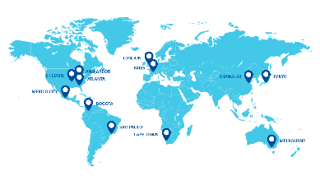



LLamasoft is the Pioneer and Global Leader of Supply Chain Modeling
Enabling companies to compete and win through better supply chain modeling
[ Reduce Cost | Improve Service | Increase Revenue | Manage Risk ]
Headquartered in Ann Arbor, Michigan USA with locations around the world
2000+
A global team of 400+ Employees
focused 100% on supply chain optimization
SUPPLY CHAIN TOP 25
INITIATIVES
Nearly all of Gartner’s Supply Chain Top 25 have designed with LLamasoft technology
Supported more than 2,000 supply chain design initiatives
>50% of FORTUNE 100
Model, analyse, and optimize their supply chains with LLamasoft technology
OVER 650
GLOBALLY ESTABLISHED
AWARDED
Global Clients
Customers include LARGEST
Global companies
Logistics & consulting firms
Military supply chains
Global health initiatives
Deloitte Fast 500
Gartner “Cool Vendors”
Pros to Know
Supply Chain Top 100
2015 Inc. 5000

Slide 8
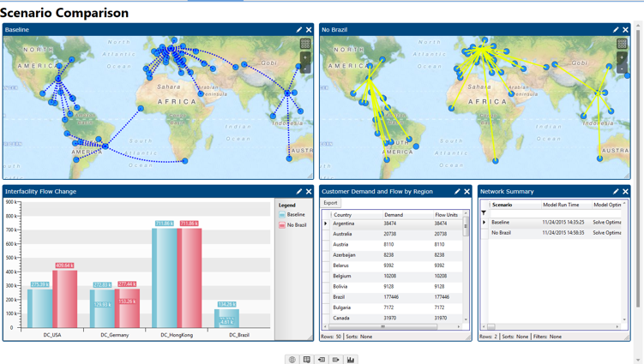
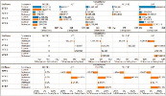
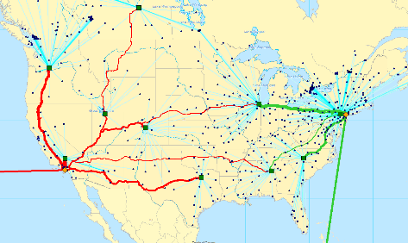
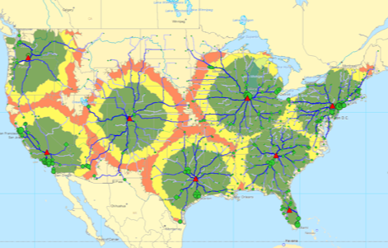
What is Supply Chain Modeling?
modeling [mod-l-ing]
the representation, often mathematical, of a process, concept, or operation of a system, often implemented by a computer program
Supply Chain Modeling
To digitally represent the structure and policies
of the physical supply chain operations
Use advance analytics to find a better or more appropriate future state
Continuously run what-if scenarios to test new strategies and react to changing market conditions or operational constraints
Network Optimization
Inventory Optimization
Demand Analysis
Product Flow-path Optimization
Vehicle Route Optimization
Enterprise Simulation

Slide 9


























































































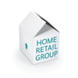












AUTOMOTIVE
CONSUMER GOODS
DEFENSE
HI-TECH/ELECTRONICS
FOOD
BEVERAGE
LIFE SCIENCES
GROCERY
LOGISTICS
APPAREL
MANUFACTURING
OIL/GAS/MINING
PUBLIC HEALTH
RETAIL
CHEMICAL

Slide 10
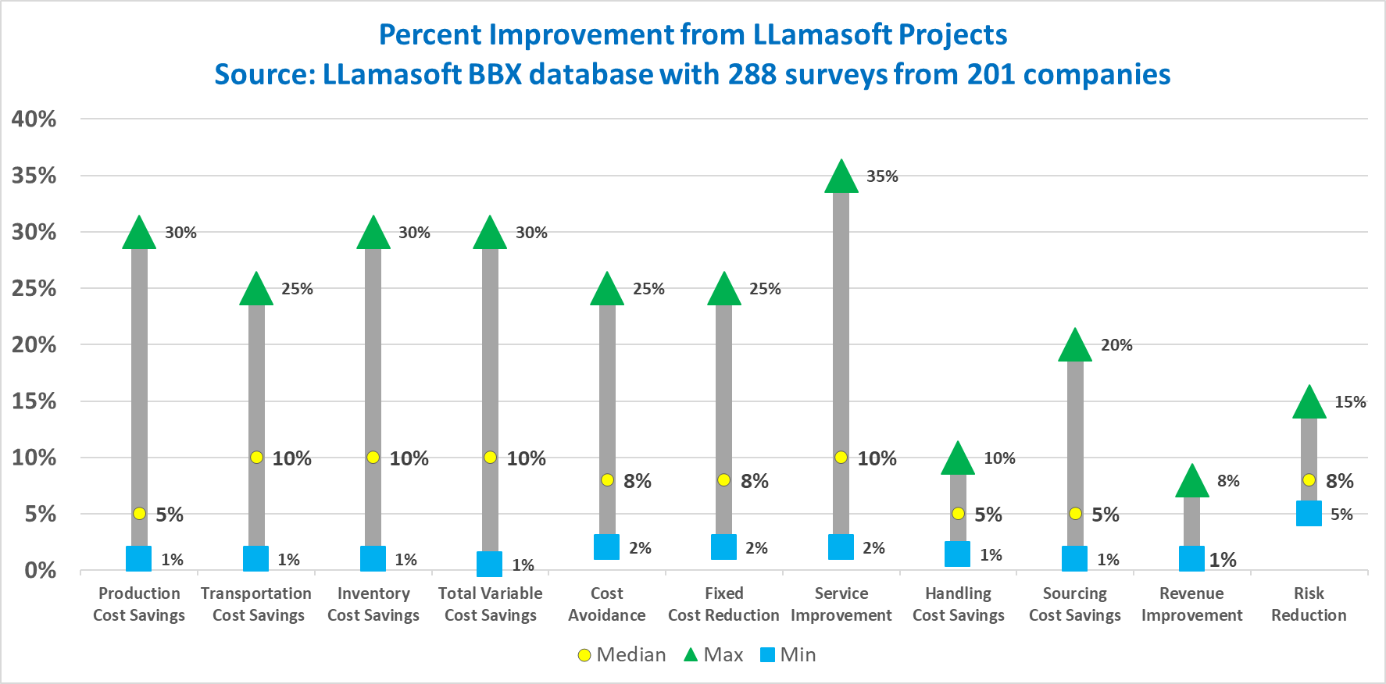
Supply Chain Design Drives Significant Benefits
Notes:
LLamasoft kicked off a benefit benchmarking program in 2015 and have thus far collected 232 surveys from customers describing the benefits they have received from their projects. Since customers often have multiple modelers and projects and the surveys are project specific, we have collected more than one data point per customer in several cases, which is why this chart shows 173 companies.
In the area of Fixed Cost reduction, LLamasoft can help identify consolidation opportunities from post M&A rationalization of assets studies. Companies also use Greenfield Analysis to re-design their DC and production footprint.
Total Variable Cost Savings is a summary across all of the metrics shown to the right, which can be derived from a combination of modeling efforts across network optimization, inventory optimization, transportation optimization, and simulation.
These metrics have been gather from customers across all industries and maturity levels. As the database grows, we plan to offer more granular views to help prospective customers receive more accurate predictions of the benefit potential. Our Solution Design Workshop methodology provides a good process for refining these benefit estimates and collaboratively helping design professional to develop a business case and proposal for management approval.

Slide 11
Agenda
“What-If?” Questions - System Design
Supply Chain Modeling - LLamasoft Overview
Supply Chain Guru

Slide 12
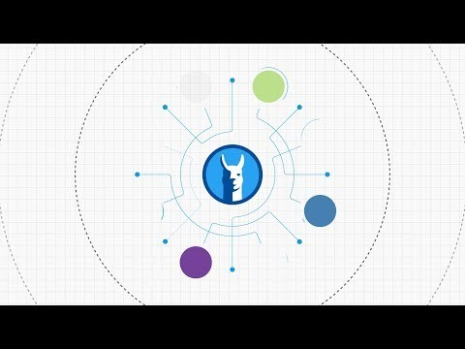
Supply Chain Design Drives Significant Benefits
Notes:
LLamasoft kicked off a benefit benchmarking program in 2015 and have thus far collected 232 surveys from customers describing the benefits they have received from their projects. Since customers often have multiple modelers and projects and the surveys are project specific, we have collected more than one data point per customer in several cases, which is why this chart shows 173 companies.
In the area of Fixed Cost reduction, LLamasoft can help identify consolidation opportunities from post M&A rationalization of assets studies. Companies also use Greenfield Analysis to re-design their DC and production footprint.
Total Variable Cost Savings is a summary across all of the metrics shown to the right, which can be derived from a combination of modeling efforts across network optimization, inventory optimization, transportation optimization, and simulation.
These metrics have been gather from customers across all industries and maturity levels. As the database grows, we plan to offer more granular views to help prospective customers receive more accurate predictions of the benefit potential. Our Solution Design Workshop methodology provides a good process for refining these benefit estimates and collaboratively helping design professional to develop a business case and proposal for management approval.

Slide 13
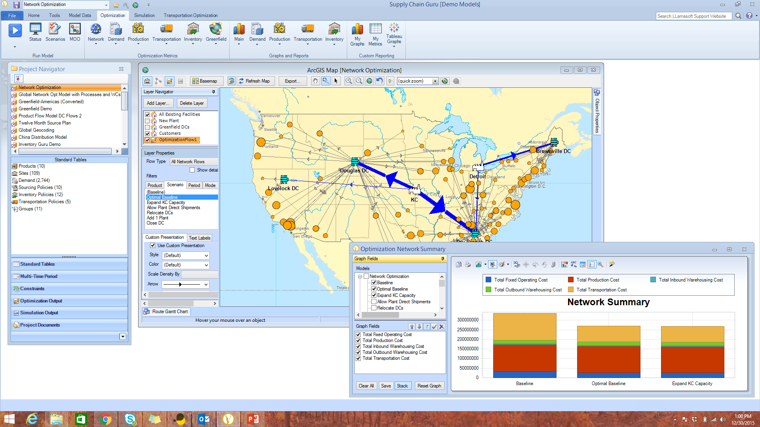

Slide 14
Thank You
www.LLamasoft.com

